Slide 1
Chapter 4 The Internet: TCP/IP Architecture
BIS 416E – Networks & Security
Dr. Omayma Younis

Slide 2
Learning Objectives
Determine the differences and similarities between the OSI model and the TCP/IP model.
Define the purpose and function of the main protocols used within each layer of the TCP/IP architecture.
Understand the purpose of the key fields of the headers of each of IP, TCP, and UDP.
Identify the function, the segment format, and the associated ports for each of TCP and UDP.

Slide 3
Introduction
The Transmission Control Protocol/Internet Protocol (TCP/IP) is the protocol suite used by most, if not all, networking environments today.
TCP/IP has been adopted as the standard model of the Internet.
TCP/IP is a suite of protocols – meaning that there is a large set of multiple protocols within the TCP/IP model.
Each protocol in the suite has a specific purpose and function.

Slide 4
OSI Model versus TCP/IP Model
Application Layer
Layer 7
Application Layer
Application Layer
Presentation Layer
Layer 4
Layer 6
Presentation Layer
Layer 5
Session Layer
Session Layer
Layer 4
Transport Layer
Layer 3
Transport Layer
Transport Layer
Layer 3
Network Layer
Internet Layer
Network Layer
Layer 2
Layer 2
Data Link Layer
Link Layer
Data Link Layer
Layer 1
Layer 1
Physical Layer
Physical Layer
7-Layer OSI Model
TCP/IP Internet Model

Slide 5
OSI Model versus TCP/IP Model
The TCP/IP model is a four-layer model similar in concept to the seven-layer OSI model.
The four layers of the TCP/IP model map out to the seven layers of the OSI, but you may find that one layer of the TCP/IP model combines multiple layers of the OSI model.
There are several protocols that direct how computers connect and communicate using TCP/IP within the TCP/IP protocol suite, and each protocol runs on different layers of the Internet model.

Slide 6
The Four Layers of the TCP/IP Model
Let’s have a deeper look at each of the four layers.

Slide 7
Application Layer: Overview
It is the top most layer of TCP/IP Model (Layer 4).
The application layer is responsible for making a network request (sending computer) or servicing the request (receiving computer).
It provides services such as e-mail, file transfer, access to the world wide web, etc. in order to exchange data between hosts.
The following are some of the popular application-layer protocols:
HTTP, FTP, SMTP & TELNET, DNS to transfer the data between applications.

Slide 8
Application Layer: Hypertext Transfer
1. Hypertext Transfer (web browsing). Related protocols include:
HTTP (Hypertext Transfer Protocol): is the protocol used on the Internet to allow clients to request HTML web pages from web servers.
HTTPS (Hypertext Transfer Protocol, Secure): allows you to connect to a web site and receive and send HTML content in an encrypted format. HTTPS is most commonly used on e-commerce sites to allow you to securely send confidential data (e.g. credit card numbers and passwords).

Slide 9



Application Layer: Hypertext Transfer
HTTP Protocol
Web Server
Client
Network
Request a webpage, insecurely
Web Server
HTTPS Protocol
Client
Network
Request a webpage, securely

Slide 10
Application Layer: File Transfer
2. File Transfer between remote hosts. Related protocols include:
FTP (File Transfer Protocol): It provides connection-oriented file transfer between a client and a server.
SFTP (Secure File Transfer Protocol): It provides the same functionality as FTP, but much more secure. It establishes a secure communication channel between client and server, through which data is transmitted in an encrypted form.

Slide 11

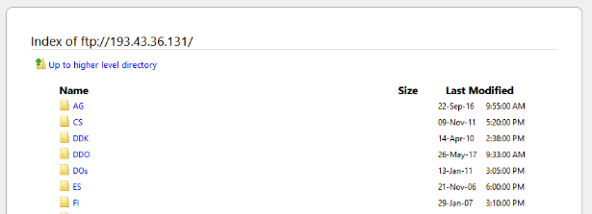
Application Layer: File Transfer
FTP Protocol
File Server
Client
Network
Use Internet browser as FTP client

Slide 12
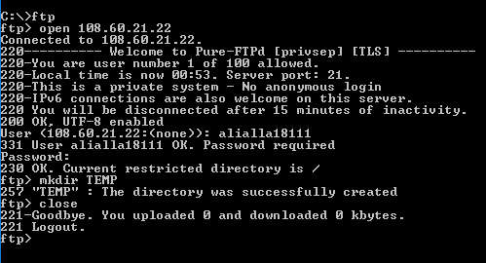
Application Layer: File Transfer
FTP Protocol
File Server
Network
Client
Use MS command-line as FTP client

Slide 13
Application Layer: Email Messaging
3. Email Messaging (Send/Receive) – related protocols include:
SMTP (Simple Mail Transfer Protocol): used to send email over Internet.
POP3 (Post Office Protocol 3): used to retrieve email from a mail server down to the client. It connects to the mail server, retrieves email messages, and deletes copies of the messages stored on the server.
IMAP4 (Internet Message Access Protocol 4): another protocol similar to POP3 that allows clients to retrieve messages from a mail server. It connects to the mail server, retrieves email messages, but the messages are not deleted on the server.

Slide 14
Application Layer: Email Messaging
Web-based Mail Client (e.g. www.gmail.com)
Non Web-based Mail Client (e.g. MS Outlook)
Client X
Mail Server X
Mail Server Y
Client Y
SMTP
SMTP
SMTP
POP3
IMAP4
Two Types of Mail Clients
Web-based Mail Client: (Gmail, Hotmail, etc.)
Non Web-based Mail Client (e.g. MS Outlook, Thunderbird, etc.)

Slide 15
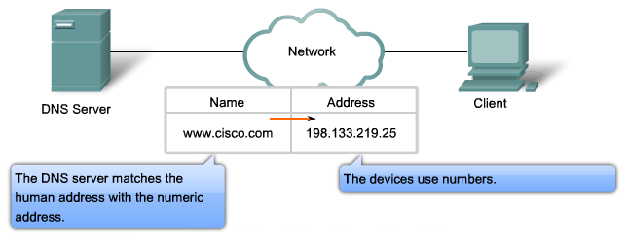
Application Layer: DNS
4. Domain Name System (DNS) Protocol:
A website can be browsed by entering either its URL address or its IP address.
The DNS (resolves) translates human-readable URLs into IP addresses.

Slide 16
Transport Layer: Overview
At the source side, the transport layer receives data from the overlying application layer, and breaks it into a group of segments and adds a header to each segment.
At the receiver side, it reassembles these segments again onto a single message to be passed to the application layer at the destination.
It supports two types of transmission: connection-oriented transmission (TCP) and connectionless transmission (UDP).
TCP Header
UDP Header
Data
Data

Slide 17
Transport Layer: Ports and Sockets
“Sockets” is an essential feature of the TCP/IP model.
A socket is a combination between an IP address and a port number, separated by a colon (e.g. 192.168.1.200 : 80)
An application uses a TCP/IP port as an identifier for that application running on a system.
When you send data from one computer to another, you send data to the port used by that application.
For example, when you type the IP address of a website in your web browser, the web browser connects to the web server running at that system by sending data on port 80 (i.e HTTP). When you send an email, your mail client connects to the mail server through port 25 (i.e. SMTP).

Slide 18
Transport Layer: Ports and Sockets
HTTP
HTTPS
FTP
SMTP
DNS
TFTP
SNMP
Application Layer
Port Number
80
443
21
25
53
69
161
TCP
UDP
Transport Layer

Slide 19
Transport Layer: TCP and UDP
The core protocols of the Transport layer are:
Transmission Control Protocol (TCP): provides a connection-oriented reliable communication service. TCP is responsible for the establishment of a TCP connection, the sequencing and acknowledgment of packets sent, and the recovery of packets lost during transmission.
User Datagram Protocol (UDP): provides a connectionless unreliable communication service. UDP is used when the amount of data to be transferred is small (such as the data that would fit into a single packet). This protocol is concerned with time rather than reliability.

Slide 20
Transport Layer: TCP Segment Format
4 Bytes (32 bits)
Bit 0
Bit 15
Bit 16
Bit 31
Source Port (16)
Destination Port (16)
Sequence Number (32)
Acknowledgment Number (32)
TCP Segment Format
TCP Header
(20-24) bytes
Header Length (4)
Reserved (6)
Code Bits (6)
Window (16)
TCP Checksum (16)
Urgent Pointer (16)
Options (0 or 32 if any)
Data (varies)

Slide 21
Transport Layer: TCP Header
Key Fields in the TCP Header
TCP Header Field | Description
Source Port | TCP port of sending host.
Destination Port | TCP port of destination host.
Sequence Number | Sequence number of the first byte of data in the TCP segment.
Acknowledgment Number | Sequence number of the byte the sender expects to receive next from the other side of the connection.
Window | Current size of a TCP buffer on the host sending this TCP segment to store incoming segments.
TCP Checksum | A simple mathematical computation used to verify the integrity (correctness) of the TCP segment.

Slide 22
Transport Layer: TCP Acknowledgement
After opening a connection … Data is transferred
Client
Webserver
1. SYN (Open)
Open a connection
(3-way handshake)
2. SYN-ACK (Ack of 1)
3. ACK (Ack of 2)
4. Data = HTTP Request
Carrying out HTTP
Request and Response
5. ACK (Ack of 4)
6. Data = HTTP Response
7. ACK (Ack of 6)

Slide 23
Transport Layer: TCP Acknowledgement
TCP Acknowledgements:
Each correct TCP segment is acknowledged.
Sender listens and waits to be sure that each TCP segment is acknowledged by the receiver.
If a segment is not acknowledged in a reasonable period of time, the sender resends it.
That’s why TCP is a reliable protocol, but takes more processing time.

Slide 24
Transport Layer: UDP Segment Format
4 Bytes (32 bits)
Bit 0
Bit 15
Bit 16
Bit 31
Source Port (16)
Destination Port (16)
UDP Header
8 bytes
UDP Segment Format
Length (16)
Checksum (16)
Data (varies)

Slide 25
Transport Layer: UDP Header
Key Fields in the UDP Header
TCP Header Field | Description
Source Port | UDP port of sending host.
Destination Port | UDP port of destination host.
Length | Length of UDP segment (including UDP header and UDP data).
UDP Checksum | A simple mathematical computation used to verify the integrity (correctness) of the UDP header and UDP data.

Slide 26
Internet Layer: Overview
The Internet Layer is responsible for addressing, packaging, and routing functions.
The Internet packet encapsulates data unit (segments) received from the overlying transport layer, and adds to its own header information.
The Internet header contains all the necessary information to deliver the packet from one end to another.
Some of the core protocols of the Internet layer are:
1. Internet Protocol (IP)
2. Address Resolution Protocol (ARP)
3. Internet Control Message Protocol (ICMP)
IP Header
Data

Slide 27
Internet Layer: IP
Internet Protocol (IP): is a routable protocol responsible for IP addressing, routing, and the fragmentation and reassembly of packets.
IP is responsible for delivering packets to the correct destination but does not guarantee delivery of the packets; that is the responsibility of transport protocols.
The IP protocol on the router decrements (usually by a value of 1) the TTL (time to live) of the packet to prevent it from running around in a “network loop.” When TTL reaches to 0, the router discards the packet.
It is responsible for the fragmentation of a large packet into smaller fragments, in order to cross a certain route that cannot handle the large packet.

Slide 28
Internet Layer: ARP
Address Resolution Protocol (ARP): is responsible for converting an IP address to the physical MAC address.
ARP sends out a broadcast message with an ARP request packet that contains the IP address of the system it is trying to find.
All systems on the local network see the message, and the system that owns the IP address for which ARP is looking replies by sending its physical address to the originating system in an ARP reply packet.
All systems maintain ARP caches (tables) that include IP address–to–physical address mappings. The ARP cache is always checked for an IP address–to–physical address mapping before initiating a broadcast.
The “ARP” utility and other related TCP/IP utilities will be covered next chapter.

Slide 29
Internet Layer: ICMP
Internet Control Message Protocol (ICMP): is responsible for providing diagnostic functions and reporting errors due to the unsuccessful delivery of IP packets.
Two utilities that use ICMP messages are: ping and tracert.
“ping” reports the time interval between sending the request and receiving the response. You can determine whether a particular IP system on your network is functioning correctly.
“tracert” traces the path taken to a particular host. This utility can be very useful in troubleshooting internetworks.
The “ping” and “tracert” utilities will be covered next chapter.

Slide 30
Internet Layer: IP Packet Format
4 Bytes (32 bits)
Bit 0
Bit 15
Bit 16
Bit 31
Version (4)
Header Length (4)
Priority and Type of Service (8)
Total Length (16)
Identification (16)
Flag (3)
Fragment Offset (13)
Time to Live (8)
Protocol (8)
Header Checksum (16)
IP Header
(20-24) bytes
IP Packet Format
Source IP Address (32 bits)
Destination IP Address (32 bits)
Options (0, or 32 bits if any)
Data (varies)

Slide 31
Internet Layer: IP Header
Key Fields in the IP Header
IP Header Field | Description
Source IP Address | The IP address of the original source of the IP packet.
Destination IP Address | The IP address of the final destination of the IP packet.
Protocol | Informs IP at the destination host whether to pass the packet up to TCP, UDP, ICMP, or other protocols.
Header Checksum | Verifies the integrity of the IP header.
Identification | The identification number of the fragment.
Time-to-Live (TTL) | Identifies the number of networks on which the packet is allowed to travel (i.e. maximum number of hops), to prevent packets from endlessly circulating on an IP internetwork.

Slide 32
Link Layer: Overview
This layer is also known as “Network Interface” Layer.
It is responsible for placing TCP/IP packets on the network medium and receiving TCP/IP packets off the network medium.
It is concerned with specifying the characteristics of the transmission medium, the nature of the signals, the data rate, and related matters.
It includes LAN technologies such as Ethernet, Token Ring, FDDI and WAN technologies such as X.25 and Frame Relay.

Slide 33
Link Layer: Ethernet
1. Ethernet (IEEE 802.3)
Technically it is referred to as the IEEE 802.3 protocol.
Ethernet is a network protocol that controls how data is transmitted over a LAN configured in a bus or star topology.
Ethernet was initially designed to run over coaxial cables, but a typical Ethernet LAN now uses special categories of twisted pair cables, or fiber optic cabling.
The protocol has evolved and improved over time and can now deliver at the speed of 10 Gbps.

Slide 34
Link Layer: Ethernet
1. Ethernet (IEEE 802.3): How it works
It defines a means of sharing the transmission medium (i.e. carrier).
So-called, Carrier Sense Multiple Access with Collision Detection (CSMA/CD).
When a device wants to send data to another, it senses the carrier (i.e. transmission medium). If the carrier is free, it sends the data packet on the network. If there is already a packet on the wire, the device that wants to send waits for some thousandths of a second to try again until it can send.

Slide 35
Link Layer: Token Ring
2. Token Ring (IEEE 802.5)
Technically it follows the IEEE 802.5 protocol.
Token Ring is a network protocol that controls how data is transmitted over a LAN configured in a ring or star topology.
Token Ring significantly decreased in popularity and was gradually phased out of business networks, as Ethernet technology began to dominate LAN designs.
Standard Token Ring supports only up to 16 Mbps.

Slide 36
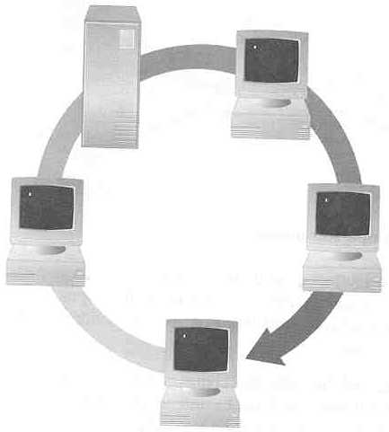
Link Layer: Token Ring
2. Token Ring: How it works
Recall the “token passing” process covered in chapter 1.
Token-passing networks move a small frame, called a token, around the network. Possessing the token grants the right to transmit. If a node receiving the token has no data to send, it passes the token to the next node.
A
B
Ack
T
T
T
T
T
data
data
data
data
T
data
E
waiting
C
T
T
T
Ack
T
D
T
data
Ack
T
T
Ack

Slide 37
TCP/IP Configuration Fundamentals
Now, you are ready to go though the fundamentals of the TCP/IP configuration:
IP addressing
Subnetting mask
Default gateway
That’s our next lesson.

Slide 38
Summary of Protocols used in TCP/IP
TCP/IP Layer | Internet Functions/Services | Protocols
Application Layer | Hypertext Transfer & Access | HTTP, HTTPS
 | File Transfer & Access | FTP, TFTP, SFTP
 | Email Messaging | SMTP, POP3, IMAP4
 | Remote Access | TELNET
 | Others | DNS, SNMP, NTP, NNTP, ...
Transport Layer | Connection-oriented Transmission | TCP
 | Connectionless Transmission | UDP
Internet Layer | Packet Delivery & Addressing | IP
 | Status & Error Reporting | ICMP
 | Logical-to-Physical Address Resolution | ARP, RARP
Link Layer | Transmission Specs | Ethernet, Token Ring, FDDI

Slide 39
Research Activity
There are more networking protocols other than the TCP/IP model, such as IPX/SPX, NetBEUI, and AppleTalk. Write short notes of each of these models.
Explain which mail protocol is better, POP3 or IMAP4, from the perspective of each of: the server storage space, mail synchronization, and privacy.
FTP is not just a protocol, it is a program as well. Compare between FTP and other file management programs such as Dropbox and Google Drive, pointing out the pros and cons of each of them.
Explain using an example how the checksum is calculated and used to detect errors within the transmitted data.
Explore and briefly explain other more protocols that reside at the link layer, such as 802.11 and FDDI.

